Slide 1
Design
Instability
Željko Obrenović, Erik Stolterman
@zeljko_obren
https://obren.info/
https://obren.info/books/designinstability.pdf

Slide 2
Agenda
Intro, definitions, model for analyzing design dynamics
Patterns of Dynamics of Design Activities
Between Design Situations and Design Outcomes
Between Design Outcomes and Resources
Between Design Situations and Design Resources
Sources of Dynamics
Discussion and Conclusions

Slide 3
Intro
Hype: design thinking, digital transformation, Conway’s Law…
“A pact of ignorance” among disciplines: “Classical” Design (e.g. architecture), UX, IT, Software, Business, Digital Transformation…
Design “courses of action aimed at changing existing situations into preferred ones” (H. Simon)
Design = “Intentional Change in Unpredictable World” (E. Stolterman)

Slide 4
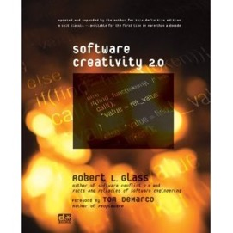
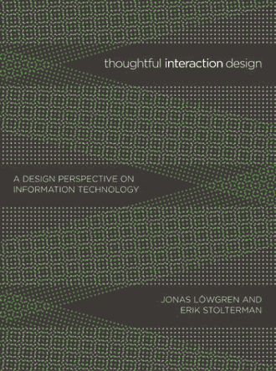
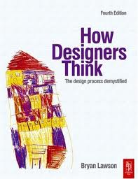
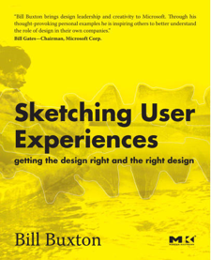
Computing Disciplines
Education
Design

Slide 5
Looking at Design Complexity Structurally
External World
Design Activity
Situation
Outcome
Resources

Slide 6
Design Dynamics
Structuring discussion using the axis of the model
Complexity characteristic for design emerges from inherent dynamics of design activities
Messy, dynamic, highly interdependent, unpredictable dynamics between design situations, design outcomes, and design resources
Universal for all design disciplines
External World
Design Activity
Situation
Outcome
Resources

Slide 7
Agenda
Intro, definitions, model for analyzing design complexity
Patterns of Dynamics of Design Activities
Between Design Situations and Design Outcomes
Between Design Outcomes and Resources
Between Design Situations and Design Resources
Sources of Dynamics
Discussion and Conclusions

Slide 8
Pattern Language
a brief descriptive name
a “motto”
optional alternative names
a summary
a short list of topics related to the pattern
a brief description of when the pattern is desirable and undesirable
a more detailed discussion based on examples from design literature

Slide 9
11 Patterns of Dynamics
Co-Evolution of Problem-Solution
Puzzle Solving
Solution Looking for a Problem
Pandora's Box
The Force Awakens
Your Design Is Your Reflection
You Are Reflection Of Your Design
Design-by-Buzzword
Conformity
Commitment
Cherry Picking

Slide 10
Patterns of Dynamics – Situation ←→ Outcome
Co-Evolution of Problem-Solution
Puzzle Solving
Solution Looking for a Problem
Pandora's Box
The Force Awakens
Your Design Is Your Reflection
You Are Reflection Of Your Design
Design-by-Buzzword
Conformity
Commitment
Cherry Picking

Slide 11
1. Co-Evolution of Problem-Solution “If you want to change something, you need to understand it, if you want to understand something you need to change it.” (Gravemeijer and Cobb 2006)
Summary: A design situation and designer’s understanding of the design situation (problem definition) changes and evolves in parallel and under the influence of design outcome and designer’s understating of potential design outcomes (design solutions).
Alternative name: Problem–Solution Flux

Slide 12
1. Co-Evolution of Problem-Solution
Topics: problems solving, problem setting, prototyping, iterative development, agile software development

Slide 13
1. Co-Evolution of Problem-Solution
Desirable:
In most complex real-world situations and new domains, as this pattern facilitates learning, stimulates communication among stakeholders, and minimizes the risk of failure
Undesirable:
In well-known domains, where it may lead to the “reinventing-the-wheel” and “not-invented-here” anti-patterns.

Slide 14
2. Puzzle Solving “A problem well put is half solved.” (John Dewey, The Pattern of Inquiry)
Summary: A design situation is viewed as a clearly defined and static problem (i.e., a problem that can be clearly stated and where it is known what form the solution should have). A design outcome is seen as a solution for this problem. Design is viewed as a problem-solving activity.

Slide 15
2. Puzzle Solving
Topics: problem-solving, the puzzle trap, education, well-scoped design sub-tasks, test-driven development

Slide 16
2. Puzzle Solving
Desirable:
In education, as well as in a limited number of practical cases for well-scoped design sub-tasks.
Undesirable:
In most real-world situations, because few design problems are fully understood before the start of design activity.

Slide 17
3. Solution Looking for a Problem “When humans possess a tool, they excel at finding new uses for it.” (Nye 2006)
Summary: Understanding of a design outcome and its possibilities leads to innovative usages of the design outcome in situations and for problems that were not initially envisioned.

Slide 18
3. Solution Looking for a Problem
Topics: novelty, creativity, curiosity, unordinary usages of ordinary things, early adopters, bitcoin, and blockchain

Slide 19
3. Solution Looking for a Problem
Desirable:
As an innovation strategy, when an organization wants to be an early adopter of emerging technology and where the organization can afford associated risks.
Undesirable:
In most other situations as it requires significant investments without tangible benefits.

Slide 20
4. Pandora's Box “Everything we design has the potential not only to solve problems but also to create new ones.” (Lawson 2005)
Summary: The consequences of a design outcome create new situations that are perceived as problematic and may ask for another design to improve it. A design outcome may become more known for the problems it caused than for the solution it provided.
Alternative name: Collateral Damage.

Slide 21
4. Pandora's Box
Topics: unexpected and undesired effects, innovative domains, expectation management, the year 2000 problem

Slide 22
4. Pandora's Box
Desirable:
In a limited number of real-world situations, when a goal is to stimulate further development of some solution without immediately benefiting from it.
Undesirable:
In most other real-world situations.

Slide 23
5. The Force Awakens “How can something seem so plausible at the time and so idiotic in retrospect?”(Bill Watterson, Calvin, and Hobbes)
Summary: Designer’s efforts to address some situation triggers reactions that radically change the original design situation. Often such reactions make the intended design outcome or a contribution of a designer obsolete or irrelevant. Such responses would typically not occur without the design activity.
Alternative names: Boomerang, Ricochet, Shoot Oneself in the Foot.

Slide 24
5. The Force Awakens
Topics: social and political issues, mass market, competition, IBM PC, vaporware, one laptop per child (OLPC) project

Slide 25
5. The Force Awakens
Desirable:
In a limited number of real-world situations, when a goal is to stimulate further development of some solution without benefiting from it.
Undesirable:
In most other real-world situations.

Slide 26
Patterns of Dynamics – Situation ←→ Resources
Co-Evolution of Problem-Solution
Puzzle Solving
Solution Looking for a Problem
Pandora's Box
The Force Awakens
Your Design Is Your Reflection
You Are Reflection Of Your Design
Design-by-Buzzword
Conformity
Commitment
Cherry Picking

Slide 27
6. Your Design Is Your Reflection "Every contact leaves a trace." (Edmond Locard)
Summary: Design resources, as well as the way how working with these resources is organized, are leaving a characteristic signature on a design outcome.
It is often possible to guess, from the design outcome, which design resources designers used, and how the working with the resources was organized.
Alternative name: Design Style.

Slide 28
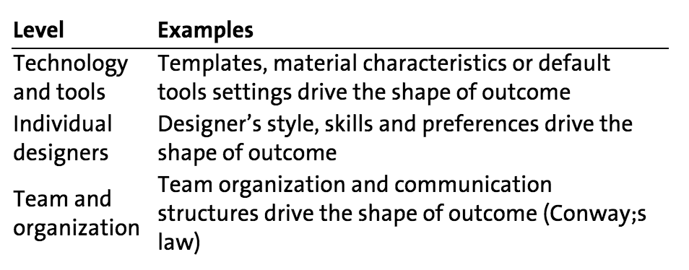
6. Your Design Is Your Reflection
Topics: constraints, consistency, templates, frameworks, convention-over-configuration, Conway's Law

Slide 29
6. Your Design Is Your Reflection
Desirable:
In situations where consistency among design outcomes is essential
Undesirable:
In complex real-world situations and in new domains where it may lead to unnecessary limited or complex solutions

Slide 30
7. You Are Reflection of Your Design “We are what we repeatedly do.” (Will Durant, The Story of Philosophy)
Summary: Design resources are adapted to a design outcome, sometimes to the point that the form and organization of design resources reflects the (intended) shape of the outcome.

Slide 31
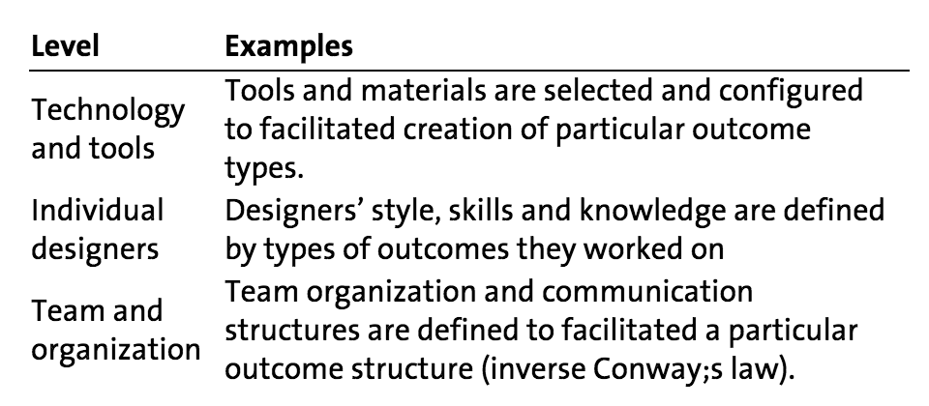
7. You Are Reflection of Your Design
Topics: Specialization, Inverse Conway’s Law, Work Optimization

Slide 32
7. You Are Reflection of Your Design
Desirable:
In situations where efficiency of design work is essential.
Undesirable:
In complex real-world situations and in new domains where it may limit designers’ ability to apply other approaches.

Slide 33
8. Design-by-Buzzword “Projects that do not capitalize on new opportunities will generally find their products unable to compete.” Boehm and Bhuta (2008)
Summary: A designer is joining a growing trend in using some technology, often in an opportunist way. New possibilities of design resources are shaping the design outcome.
Alternative names: Design-by-Buzzword, Opportunistic Design.

Slide 34
8. Design-by-Buzzword
Topics: exploiting new opportunities, hype, trends, hackathons, startups, end-user development and meta-design

Slide 35
8. Design-by-Buzzword
Desirable:
In fast-changing domains where capitalization on new opportunities is a crucial competitive advantage.
Undesirable:
In real-world situations and in well-known domains where it may lead to unnecessary complex solutions.

Slide 36
Patterns of Dynamics – Resources ←→ Outcome
Co-Evolution of Problem-Solution
Puzzle Solving
Solution Looking for a Problem
Pandora's Box
The Force Awakens
Your Design Is Your Reflection
You Are Reflection Of Your Design
Design-by-Buzzword
Conformity
Commitment
Cherry Picking

Slide 37
9. Conformity “When in Rome, do as the Roman’s do.”
Summary: To minimize risks in a new design situation, designers use popular and proven resources with established best practices.
Conformity may be driven by positive experiences of others in similar situations, popularity of design resources, or mandatory requirements.
The usage of a design resource further contributes to establishment and reputation of the resource and its usage in new design situations.

Slide 38
9. Conformity
Topics: popularity, compliance, communities, peer pressure, legal requirements, education

Slide 39
9. Conformity
Desirable:
When conformity is mandatory, or when designers can benefit from joining a broader community.
Undesirable:
In new domains where there are no established best practices, or in areas where capitalization on new opportunities is crucial.

Slide 40
10. Commitment “It is a poor craftsman that blames his tools.”
Summary: In a new design situation designers use tools they committed to beforehand.

Slide 41
10. Commitment
Topics: learning, standardization of work, tool development, “eating its own dog food,” “if all you have is a hammer, everything looks like a nail”

Slide 42
10. Commitment
Desirable:
When designers want to master resource usage or further improve the resource itself.
Undesirable:
In complex real-world situations where over-commitment may lead to worse design outcomes and lost opportunities.

Slide 43
11. Cherry Picking “Do one thing and do it well.”
Summary: Design situations are selected based on how quickly designers can approach these situations with preferred or available resources. Other situations are avoided.
Alternative names: Low-Hanging Fruits, Selective Design.

Slide 44
11. Cherry Picking
Topics: focusing usage of resources, specialization, work efficiency, minimizing risks

Slide 45
11. Cherry Picking
Desirable:
In new domains where there are plenty of opportunities or little competition, or when an organization needs to focus usage of scarce resources.
Undesirable:
In complex real-world situations as it may stimulate solving easy instead of important problems.

Slide 46
11 Patterns of Dynamics
Co-Evolution of Problem-Solution
Solution Looking for a Problem
Pandora's Box
The Force Awakens
Puzzle Solving
Your Design Is Your Reflection
You Are Reflection Of Your Design
Design-by-Buzzword
Conformity
Commitment
Cherry Picking

Slide 47
Agenda
Intro, definitions, model for analyzing design complexity
Patterns of Dynamics of Design Activities
Between Design Situations and Design Outcomes
Between Design Outcomes and Resources
Between Design Situations and Design Resources
Sources of Dynamics
Discussion and Conclusions

Slide 48
The Moving Target Problem
Design situations, resources, and outcomes change more rapidly than designers’ understanding of them
Designers need to work without having significant experience and understanding
Waiting to obtain more knowledge and better understanding is risky
the issues may quickly become less relevant or obsolete

Slide 49
The Moving Target Problem
The force awakens pattern: rapid changes as a reaction to a design effort + lack of understanding / experience with similar situations
The co-evolution of problem-solution pattern designers are dealing with new situations with little previous projects and experiences
The Design-by-Buzzword pattern, may contribute to the constant change, introducing new opportunities that change design situations

Slide 50
Increasing Interconnectivity
Design situations, design outcome, design resources are increasingly more globally interconnected
There are more ways or channels through which a design activity may be influenced

Slide 51
Increasing Interconnectivity
The force awakens pattern is often a direct consequence of the impact of design outcomes on external, globally connected context
The Pandora's Box pattern is a consequence of a chain of unforeseen consequences of design in interconnected environments
The conformity pattern is in part a result of the ability of design professionals to quickly obtain globally accessible knowledge
The Design-by-Buzzword pattern may lead to successful design outcomes because of globally connected environments
enable more people to interact with design and find novel applications

Slide 52
Learning and Creativity
Behaviors and expectations of people are continually changing due to their learning and creativity

Slide 53
Learning and Creativity
The co-evolution of problem-solution pattern is often a consequence of learning and creativity of both designers and their clients
The force awakens pattern is a consequence of people outside the design activity learning about the value of the design outcome
The solution looking for a problem pattern is a consequence of people’s creativity in finding new uses for existing solutions
The commitment pattern, committing to using some design resources facilitates learning and mastering of its usage
The conformity pattern is a consequence of design professionals being able to quickly learning how to use the same popular design resource
the eating its own dog food pattern is an attempt to stimulate intensive learn within the design company about their designs
The cherry picking pattern may be viewed as an attempt to avoid risks and costs of extensive learning

Slide 54
Tacit Knowledge and Skills
Designers are relying on tacit knowledge and skills that they do not fully understand and cannot fully explain
Because of its implicit nature, it is hard to predict what effects tacit knowledge will have in design

Slide 55
Tacit Knowledge and Skills
The co-evolution of problem-solution pattern is often a consequence of actions based on intuition, judgment, and tacit skills
The commitment pattern as mastering usage of tools often requires acquiring an extensive set of tacit knowledge and skills

Slide 56
Social Dynamics
Design situations, resources, and outcomes are complex socio-technical systems, with complex, difficult to predict dynamics

Slide 57
Social Dynamics
The force awakens pattern is often a consequence of complex social dynamics in society
The Design-by-Buzzword pattern is in many ways a consequence of social dynamics related to the adoption of new technologies
The conformity pattern may be viewed as a consequence of workings of social mechanisms, such as peer-pressure in the community of designers, popularity of some design resources
The commitment pattern may be influenced by social dynamics related to promotion of some design resource
The your design is your reflection pattern, is related to social dynamics within design organizations and teams

Slide 58
Lack of Strong Principles, Theories, Laws
Designers are dealing with poorly understood phenomena, for which we do not have strong underlying principles, theories, and laws

Slide 59
Lack of Strong Principles, Theories, Laws
The force awakens and Pandora's Box patterns, are partially a consequence of our inability to estimate the impact of our design efforts in a broader context
The co-evolution of problem-solution pattern partially happens due to lack of knowledge and theories about a particular design situation and our inability to develop sufficient understanding of the design situation beforehand
The solution looking for a problem and Design-by-Buzzword patterns, practically assume that our current understanding and predicted usages of some technology are limited, and that new, unpredicted usages will emerge.

Slide 60
Agenda
Intro, definitions, model for analyzing design complexity
Patterns of Dynamics of Design Activities
Between Design Situations and Design Outcomes
Between Design Outcomes and Resources
Between Design Situations and Design Resources
Sources of Dynamics
Discussion and Conclusions

Slide 61
Design Instability and Complexity = Design
The instability and unpredictability of a design process as a defining characteristic of any design activity
A lack of stability is a requirement for any process to be called design
If a process is more predictable and stable, we would typically not see it as a design activity. Or, at best, we would call it a routine design
The key question is not how to make design activities stable and entirely predictable, but how to deal with the resulting complexity

Slide 62
Joggling as a Metaphor for Design

Slide 63
Design Dynamics Framework As a Tool
Visibility
Insights about why particular design approaches are more (or less) successful in dealing with design complexity
A strong movement from prediction based management toward management that adapts to change
Remedy
Remove / introduce particular dynamics
Prevention
Prevent occurrence / non-occurrence of particular dynamics

